Slide 1
VDR co-design and development
Dr. Darren Beriro, Principal Geoscientist
VENTURA Showcase
24th April 2024

Slide 2



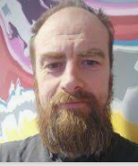
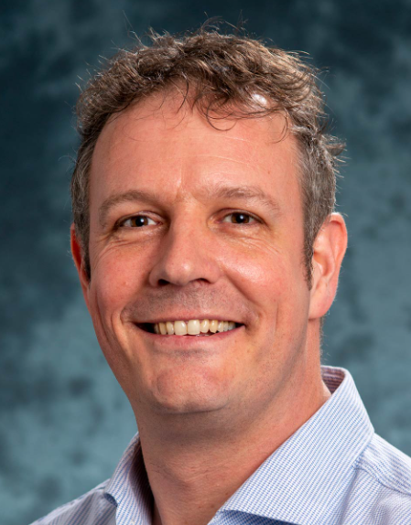


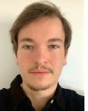
Introduction
The primary BGS contribution to VENTURA was to oversee the co-design and software development of the Virtual Decision Room (VDR) solution. The aim was to produce a user-friendly, web hosted, interface to the complex water systems model developed by Imperial while addressing the requirements identified through the investigations by UCL.
BGS informatics team design and develop software according to good software development principles such as user focussed design methodology, agile development sprints, use of industry standards for API design and documentation and following FAIR data principles – making data as open as possible but as closed as necessary.
2

Slide 3



Fit to framework
WSIMOD setup
API development
WSIMOD use
WSIMOD + VDR
final WSIMOD
MODELLING
spatial
domain
VDR
workflows
VDR
prototype
VDR
testing
VDR use
DIGITAL
final VDR
problem
formulation
CLD development
SYSTEMS
THINKING
CLD + VDR
final
CLD
ENGAGEMENT
scoping
workshops
VDR workshops
CLD workshops
VDR feedback
VDR use
SHOWCASE

Slide 4
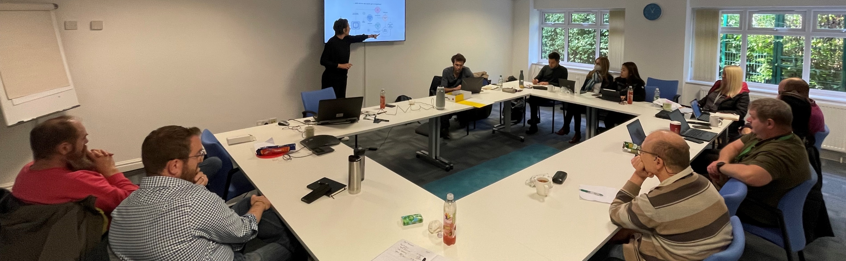
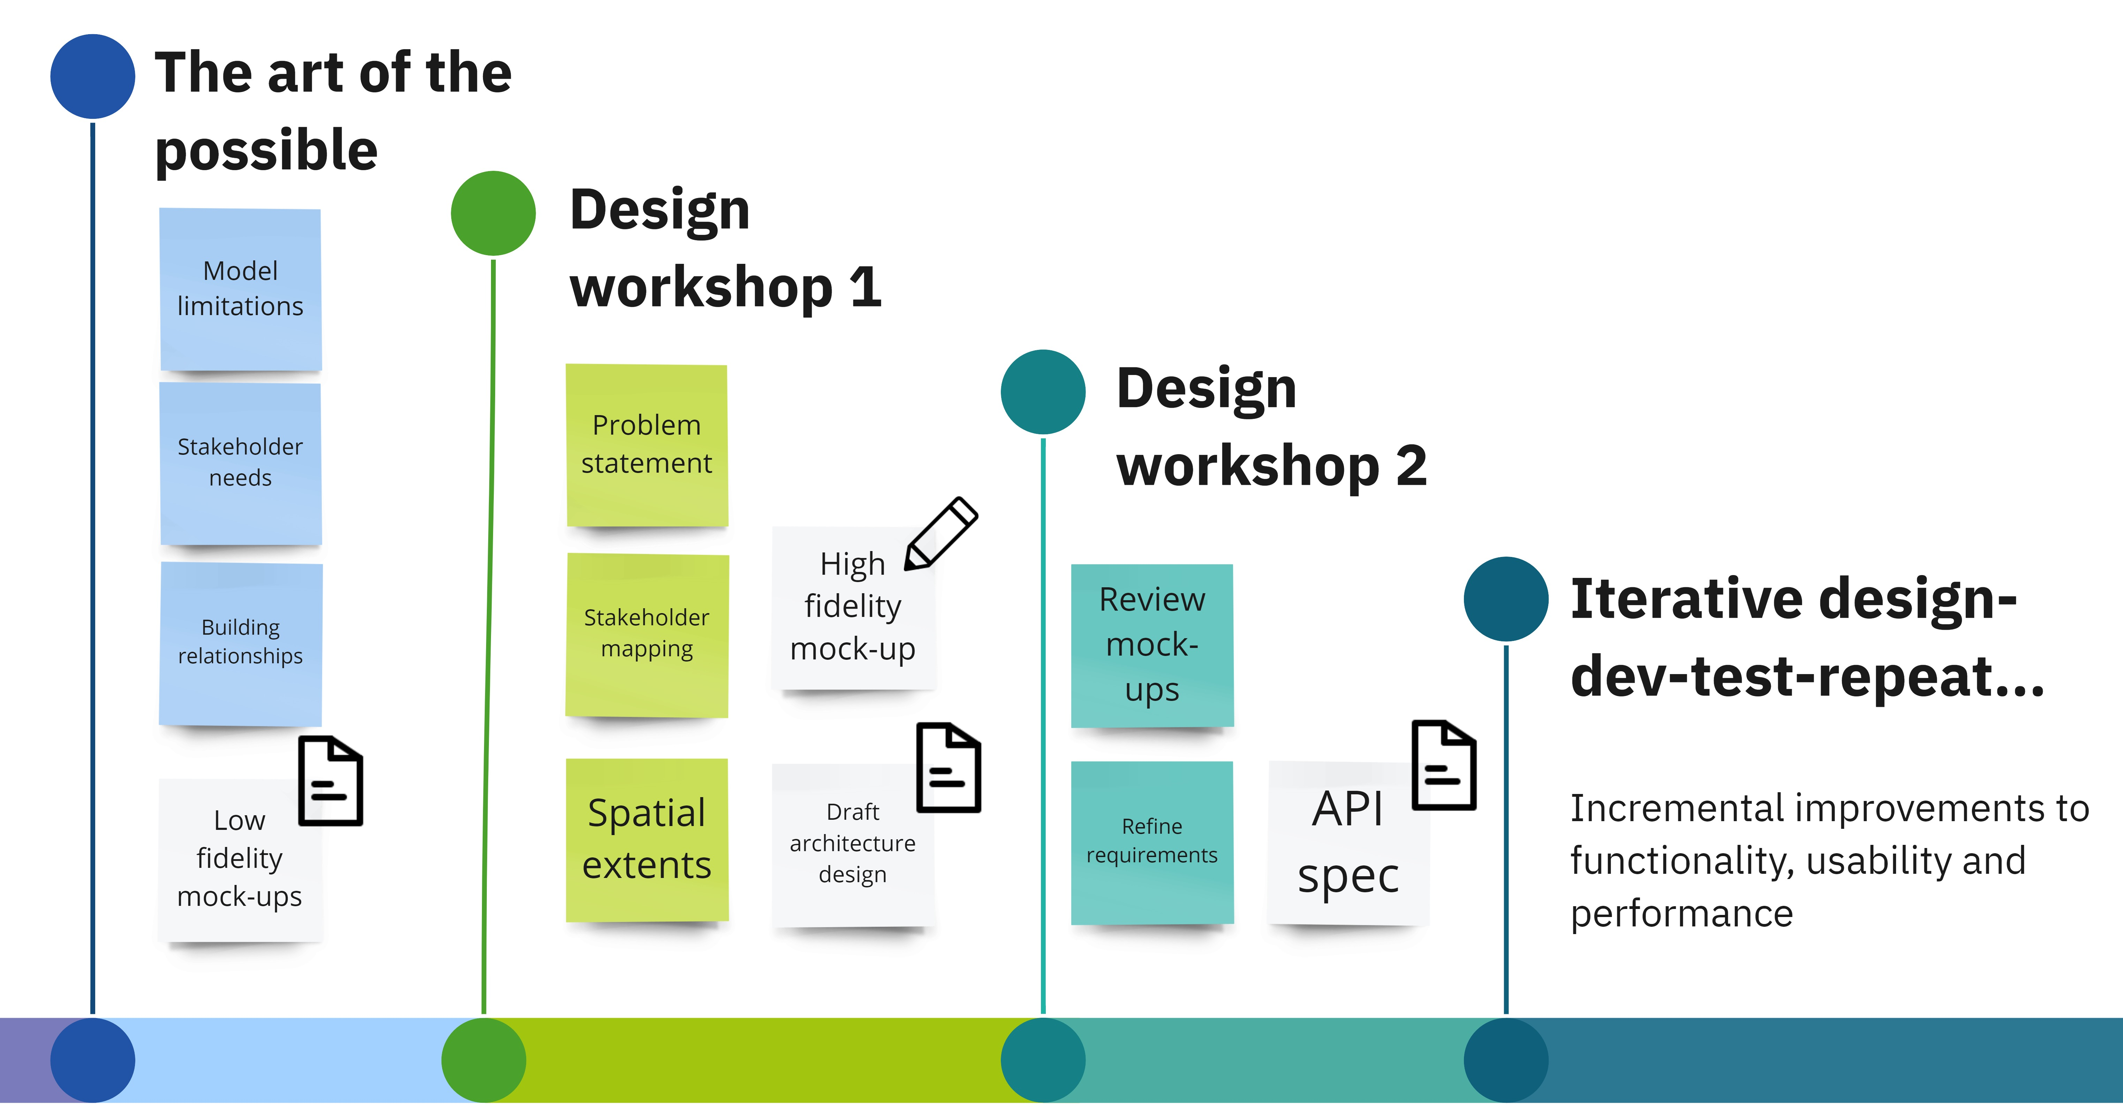
The process
VDR design and development process
4

Slide 5
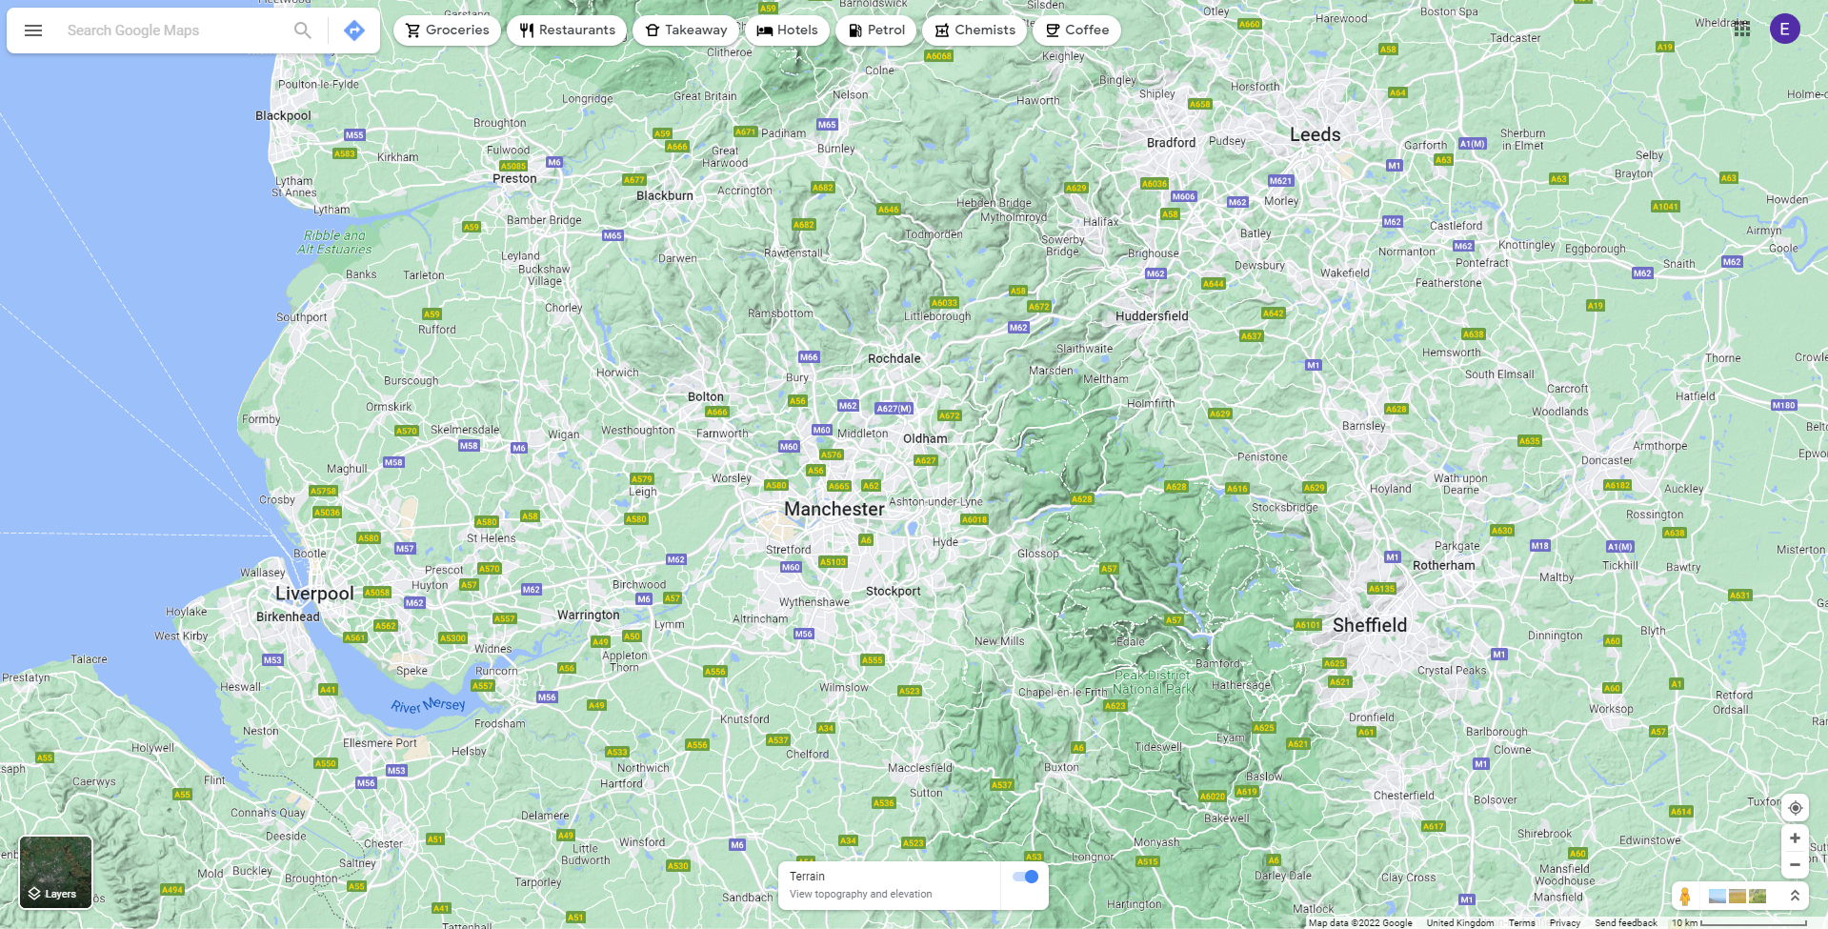


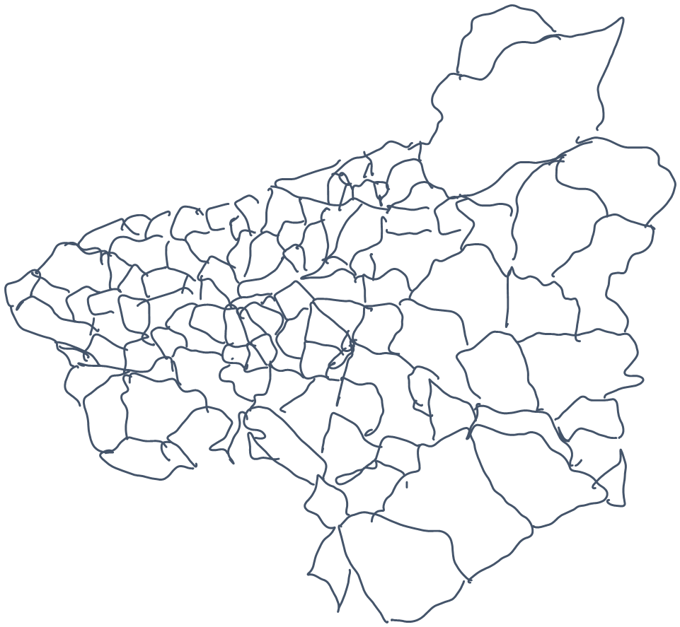
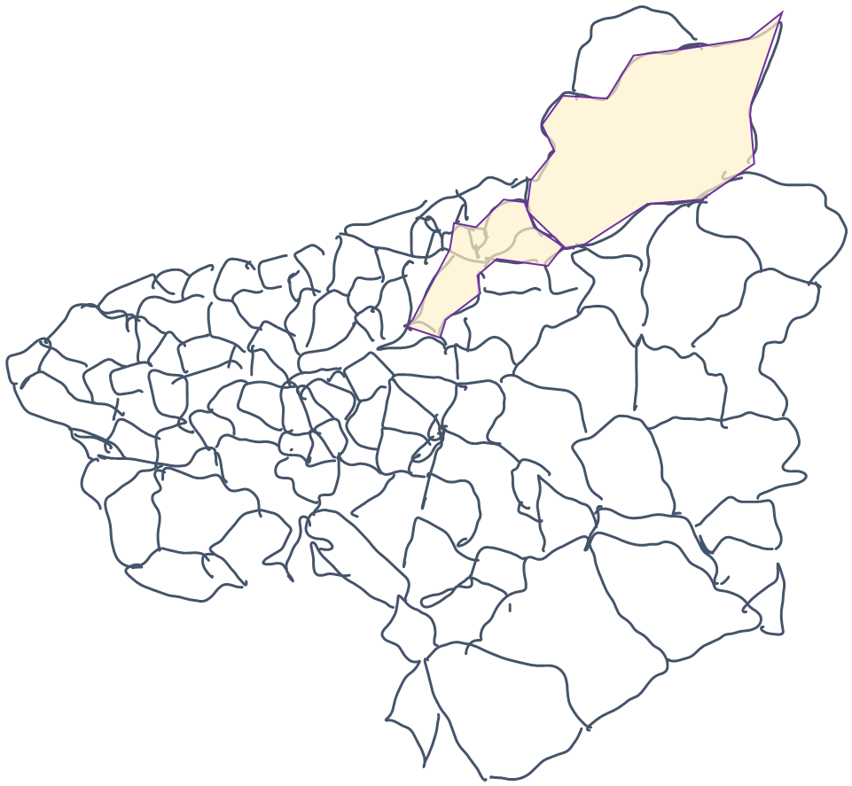
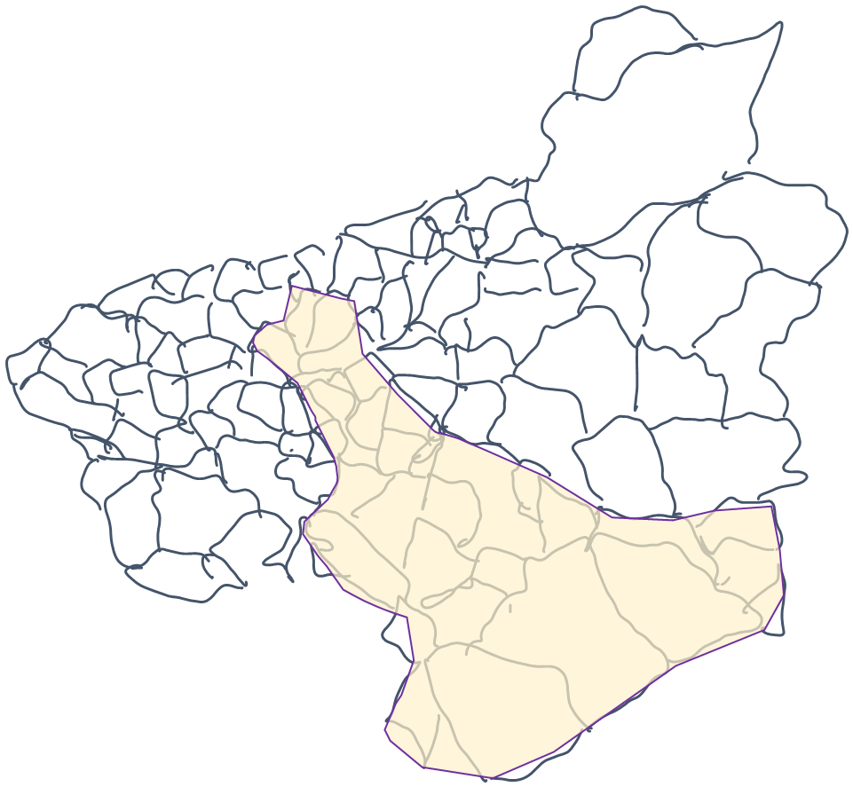


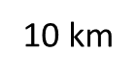























































Low fidelity mock-up – PowerPoint sketches
CATCHMENTS
SUDS STUDIO
Select
RIVERS
LPAS
DEV
NET
Edit
Analysis
Upper area regeneration and re-planting
0
1
2
Add
Delete
Options
MAIN INTERACTION – OPTION EXPLORER

Slide 6
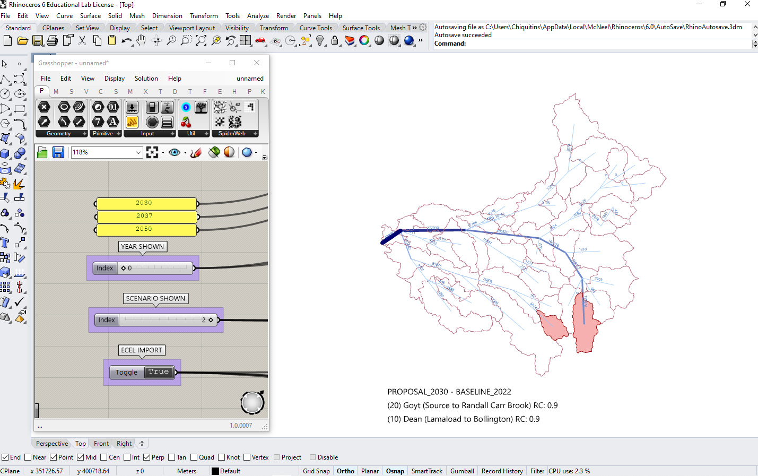
Alternative technologies to demo and test the solution prior to development – Rhino

Slide 7
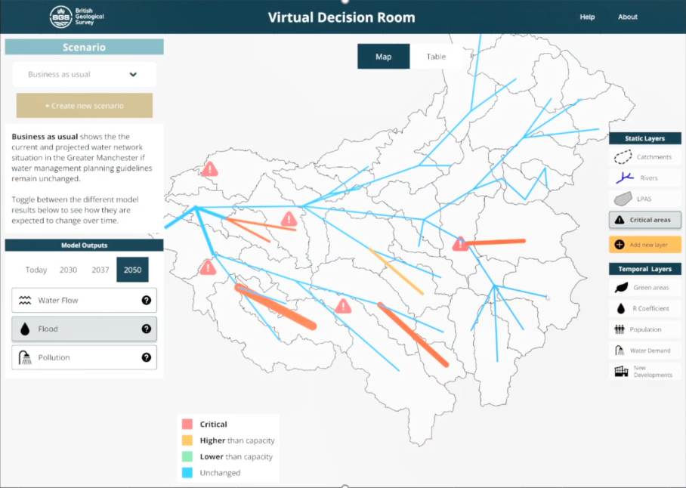
High fidelity interactive mock-up – Figma prototype

Slide 8
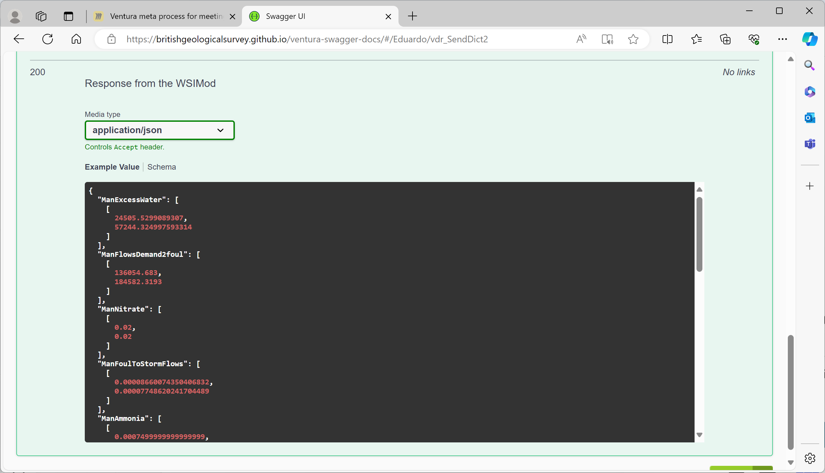
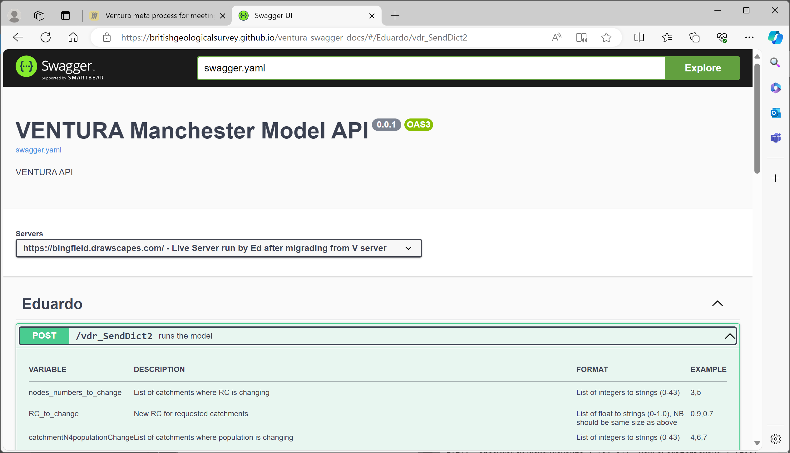
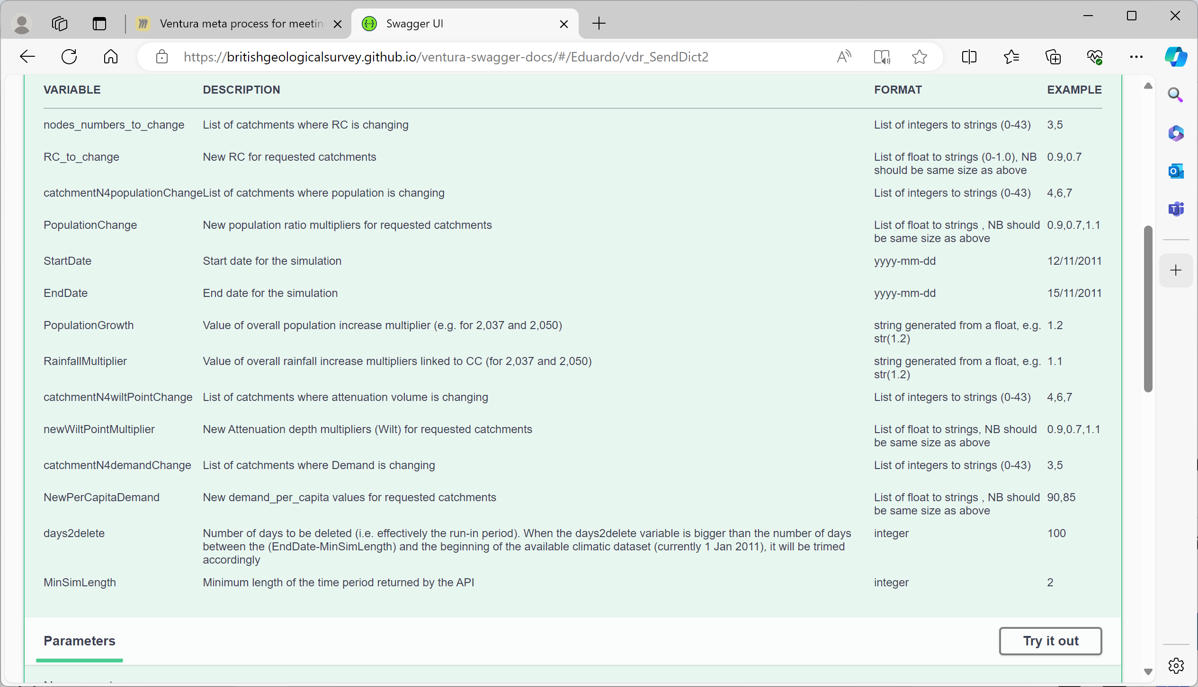
Results
API specification documented in OpenAPI standard. Critical in making sure BGS and Imperial technical specialist were able to work together effectively.

Slide 9
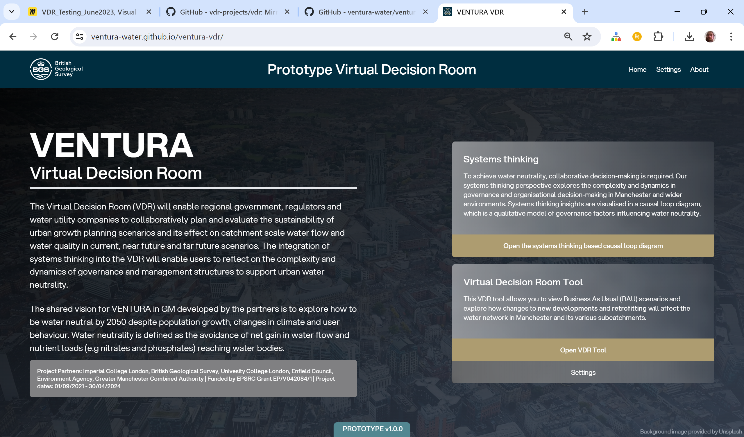
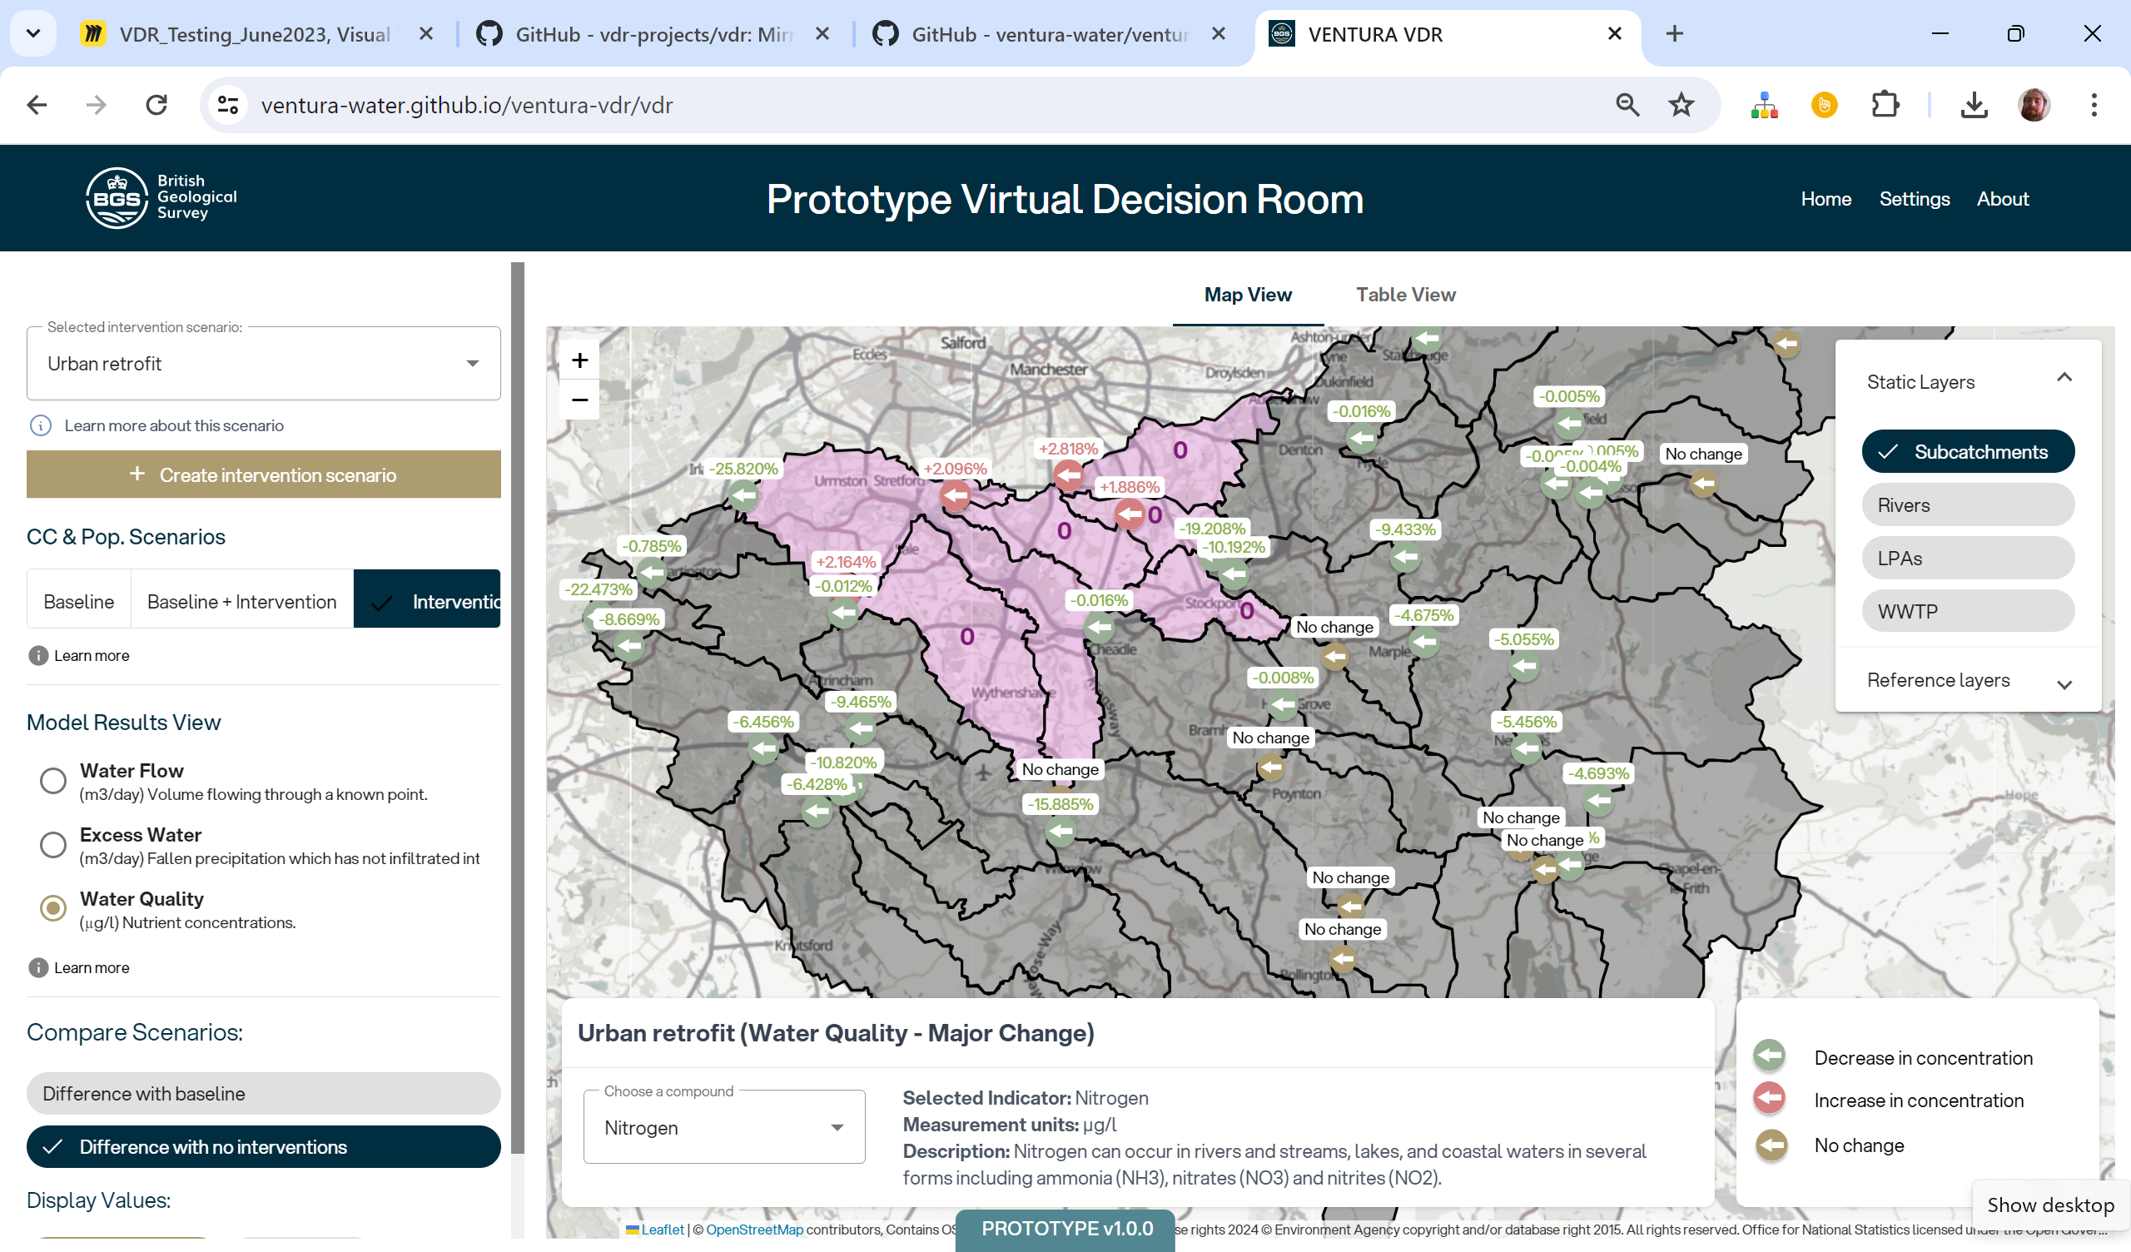
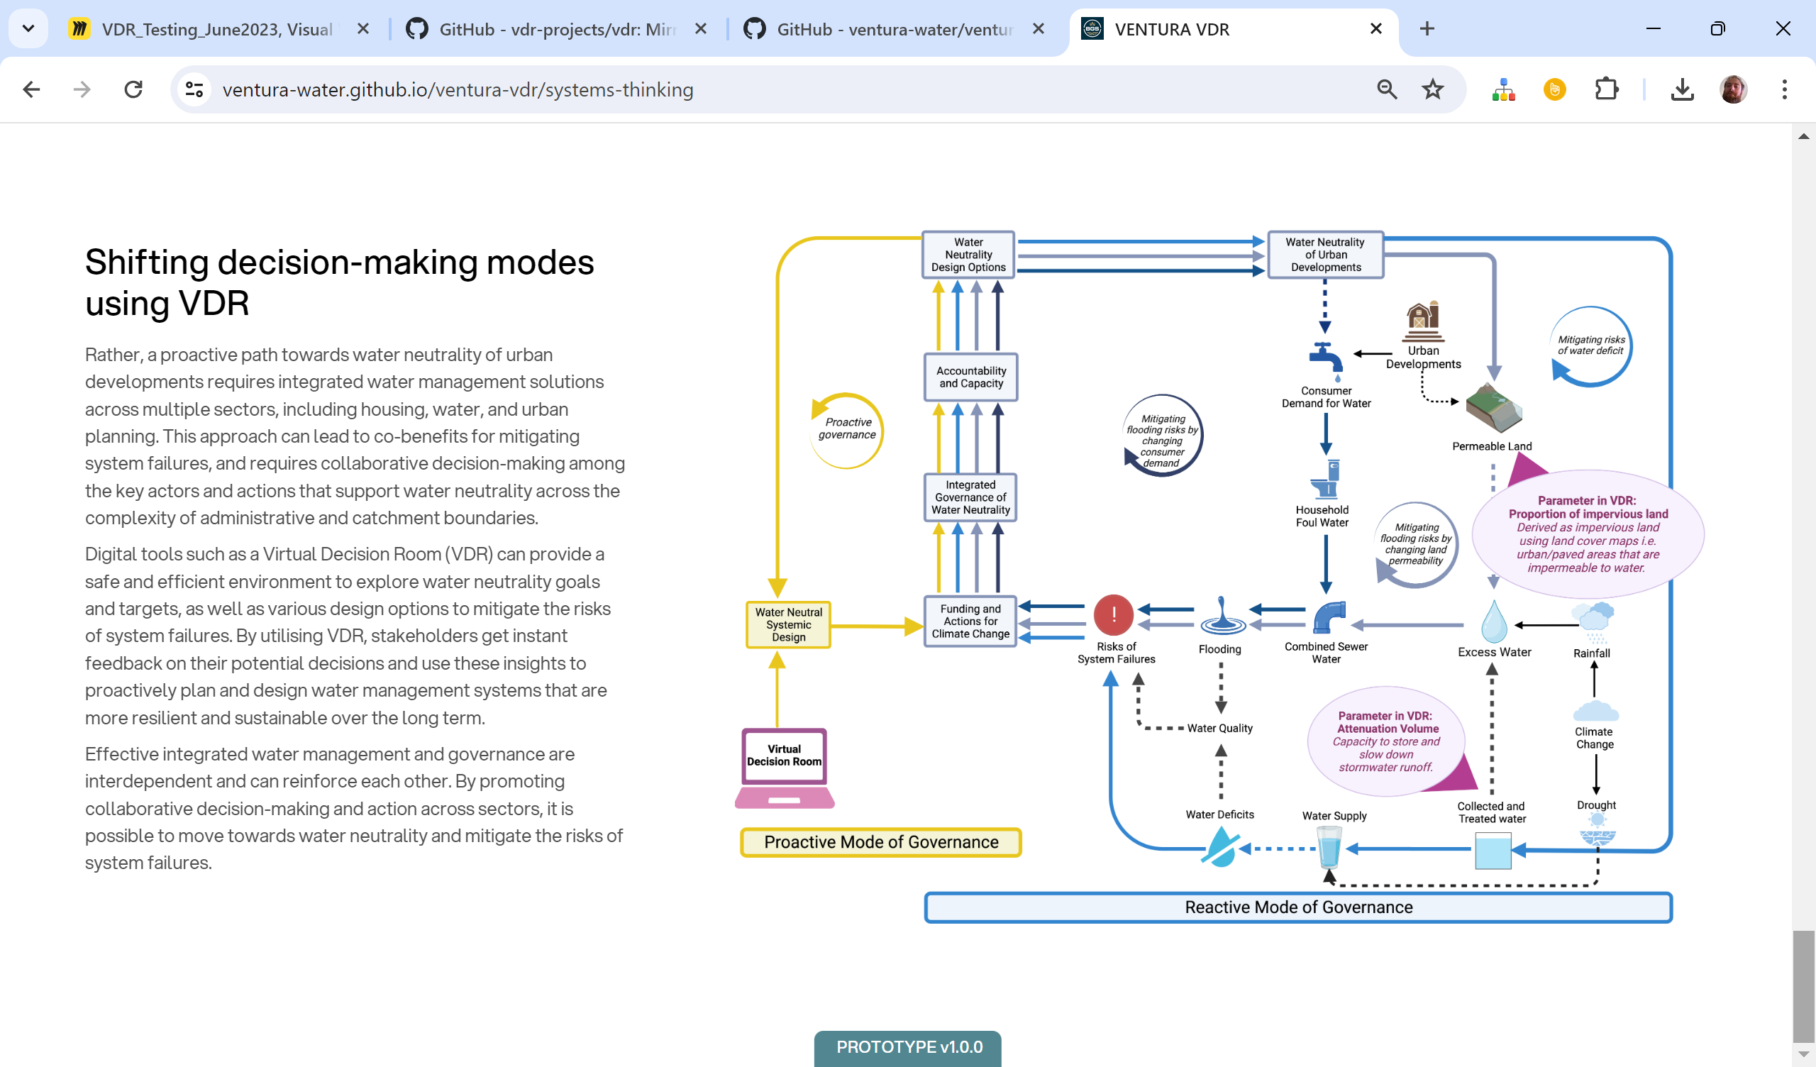
Results
Web based VDR prototype:
Static system dynamics causal loop diagrams
Real-time access via API to Greater Manchester WSIMOD
User interface

Slide 10
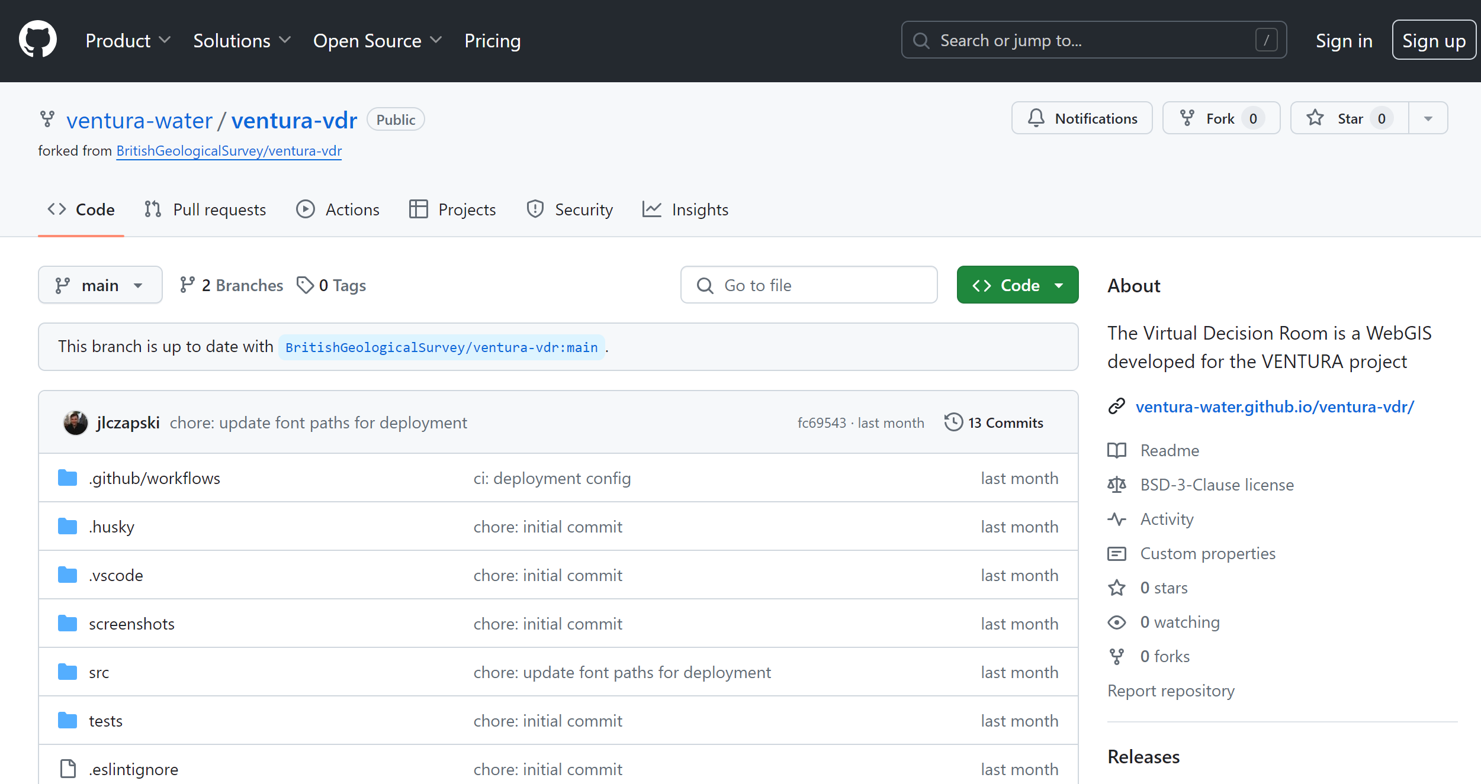
Results
Open-source code in BGS GitHub
WSIMOD
API
VDR

